Slide 1
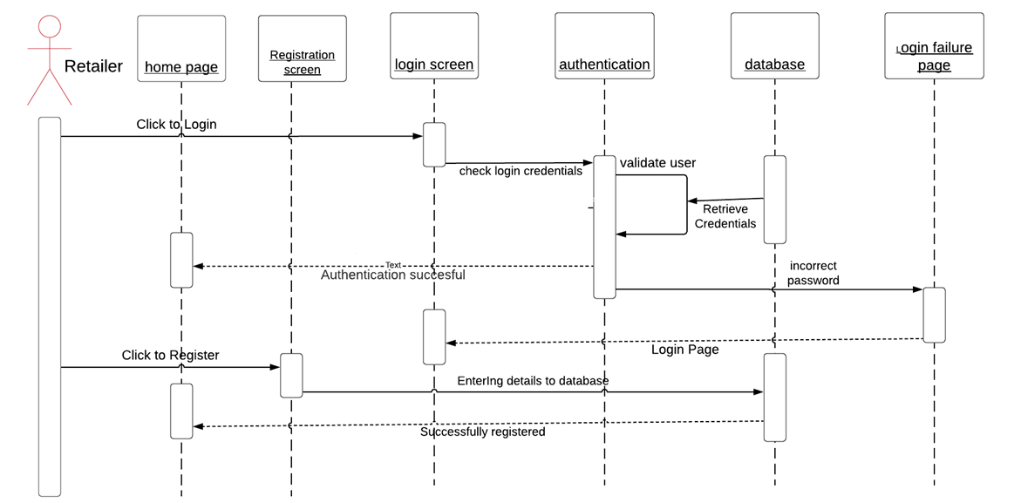
Sequence diagram for Retailer Login

Slide 2
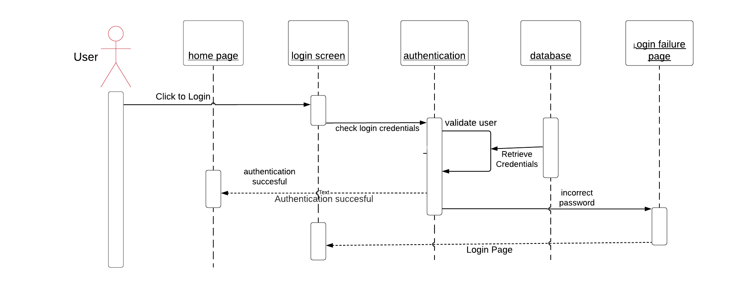
Sequence diagram for Admin and Sales Person Login

Slide 3
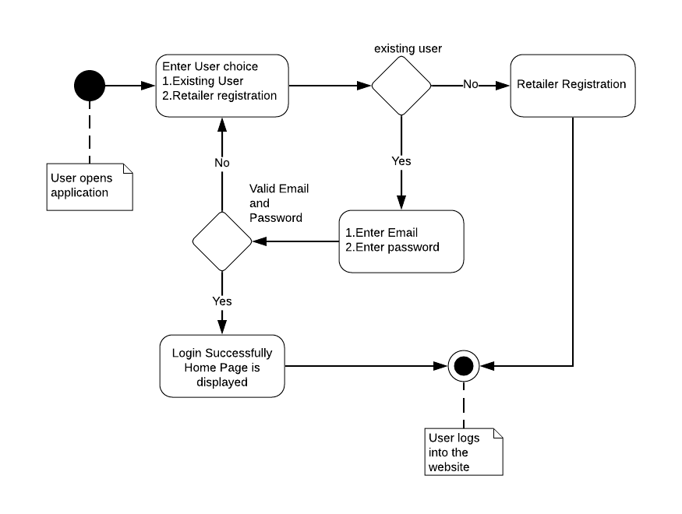
Activity diagram of Login

Slide 4
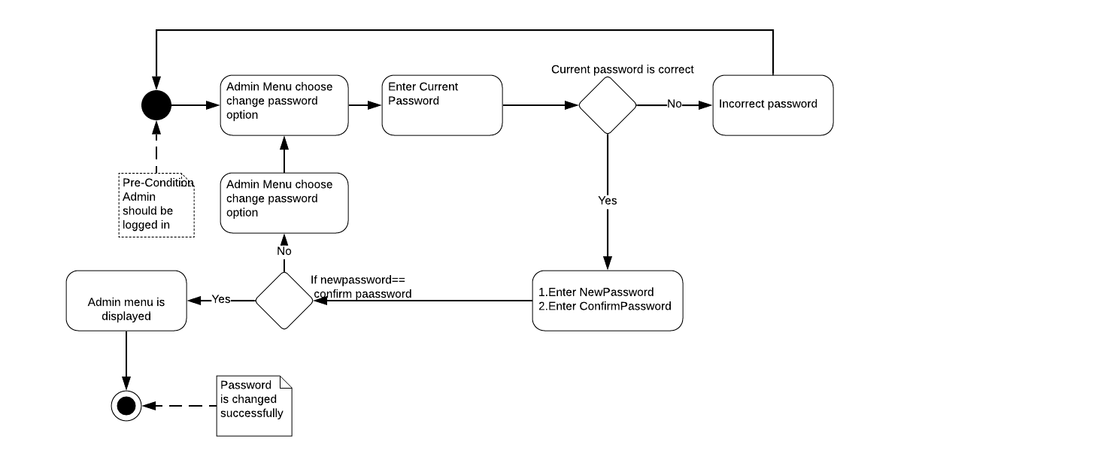
Activity diagram of Changing Admin Password

